Slide 1


DAYANANDA SAGAR UNIVERSITY
SCHOOL OF ENGINEERING
Computer Science and Engineering (AIML)
Minor Project Final Presentation
Phase II
ECG PREDICTION AND ANALYSIS USING MACHINE LEARNING TECHNIQUES
Under the Supervision
Dr.Jayavrinda Vrindavanam ,Dr. Kirankumar Dyawarkonda and Prof.Pradeep Kumar k
Presented By:
Sana Banu (ENG22AM0053)
Sahana Priya G (ENG22AM0050)
Nagaboina Dharsini (ENG22AM0036)
Pooja N P (ENG23AM1002)

Slide 2
Content
SDG
Introduction
Problem Definition and Objectives
Literature Survey
Detailed Methodology with Architectural Diagram
Experimentation
Comparison of Results with Graphical Representation and Table.
Code Execution
Publication
References

Slide 3
Student Contribution
USN | Student Name | Contribution
ENG22AM0036 | Nagaboina Dharsini | App Development
ENG22AM0053 | Sana Banu | App Development
ENG22AM0050 | Sahana Priya G | Website Development
ENG23AM1002 | Pooja N P | Website Development

Slide 4
Sustainable Development Goals (SDGs)
Good health and well-being
Detects heart diseases early, reducing mortality rates.
Enables remote heart monitoring in underserved areas.
Provides personalized treatment plans for better care.
Promotes preventive healthcare through risk analysis

Slide 5
Introduction
Cardiovascular diseases (CVDs) cause 17.9 million deaths annually, making early detection crucial for effective treatment.
ECG systems face issues with accuracy due to poor algorithms, integration, and artifact management, leading to unreliable analysis.
There is a need for better diagnostic accuracy, effective ECG data management, and seamless healthcare integration.
A mobile app using machine learning, artifact filtering, and secure data handling could address these issues and improve patient care

Slide 6
Problem Statement
• Problem:
Current ECG systems face challenges with data management, algorithm inefficiencies, and integration challenges, leading to inaccurate diagnoses and inadequate monitoring; a mobile application is needed to address these critical issues.
• Solution:
Ultimately, our proposed mobile app harnesses advanced machine learning for accurate ECG analysis, features real-time artifact management, integrates seamlessly with healthcare platforms, and prioritizes user-friendly design and data security

Slide 7
Literature Review
Paper Title | Purpose | Efficiency | Methodology | Limitation
An ECG detection device based on Convolutional Neural Network | Integrates convolutional neural networks (CNN) for the real-time detection and diagnosis of premature atrial contractions. | The CNN model used in the device achieves an accuracy of 95.1%, with a precision of 95% and a recall rate of 97.9%. | The system combines hardware and software. It utilizes the MSP432P401R microcontroller and the ADS1292 bioelectric sensor for signal monitoring. | The current system is limited to detecting Premature Atrial Contractions (PAC) and requires improvements in terms of accuracy.
Medical Internet of Things for Classification of Pathological ECG Beats Based on Fractional Fourier Transform and Hyperparameter Tuning | The paper aims to use the Medical Internet of Things (MIoT) and advanced technologies like 6G.It integrates Fractional Fourier Transform (FrFT) and Deep Transfer Learning (DTL) for efficient ECG . | The proposed system achieved a classification accuracy of 99.68%. The DTL model with hyperparameter tuning proved to be more accurate and efficient . | Data Collection, Data Augmentation, Model Architecture. | The current model is limited to detecting five categories of heart conditions and requires further development to handle a wider variety of ECG abnormalities.

Slide 8
Paper Title | Purpose | Efficiency | Methodology | Limitation
ECG Diagnosis Device Based on Machine Learning | Develop a portable ECG diagnosis device using machine learning for real-time ECG signal processing and abnormality . | Achieved a diagnostic accuracy of 94.92% for detecting normal and abnormal ECG signals. | Data Preprocessing, Deep Learning Architecture, Fiducial Point Detection | The tool lacks integration with advanced signal processing techniques and is limited to fiducial point detection​
A Deep Learning-Based ECG Segmentation Tool for Detection of ECG Beat Parameters | Develop an automated ECG segmentation tool using deep learning to segment ECG beats and detect fiducial points (P, QRS, T waves) | Achieved 95% accuracy in ECG segmentation and 99.4% accuracy in fiducial point detection. | Preprocessing involved noise removal .The Conv-BiLSTM model was used to segment the ECG waves and detect fiducial points. | The tool lacks advanced signal processing integration and is limited to fiducial point detection​
Beat-wise Classification of Arrhythmia Using Novel Combination of ECG Signal with ML Algorithms | machine learning-based method for classifying arrhythmia at the beat level using a combination of ECG(derived from wavelet transformation). | The best performance was achieved of 94.7% using both signal specific and signal independent feature | The MIT-BIH Arrhythmia Database, which contains ECG recordings from various patients, was used for this study. | requires optimization in terms of resource usage and computational complexity for real-time applications​(Beat-wise Classificatio…).

Slide 9
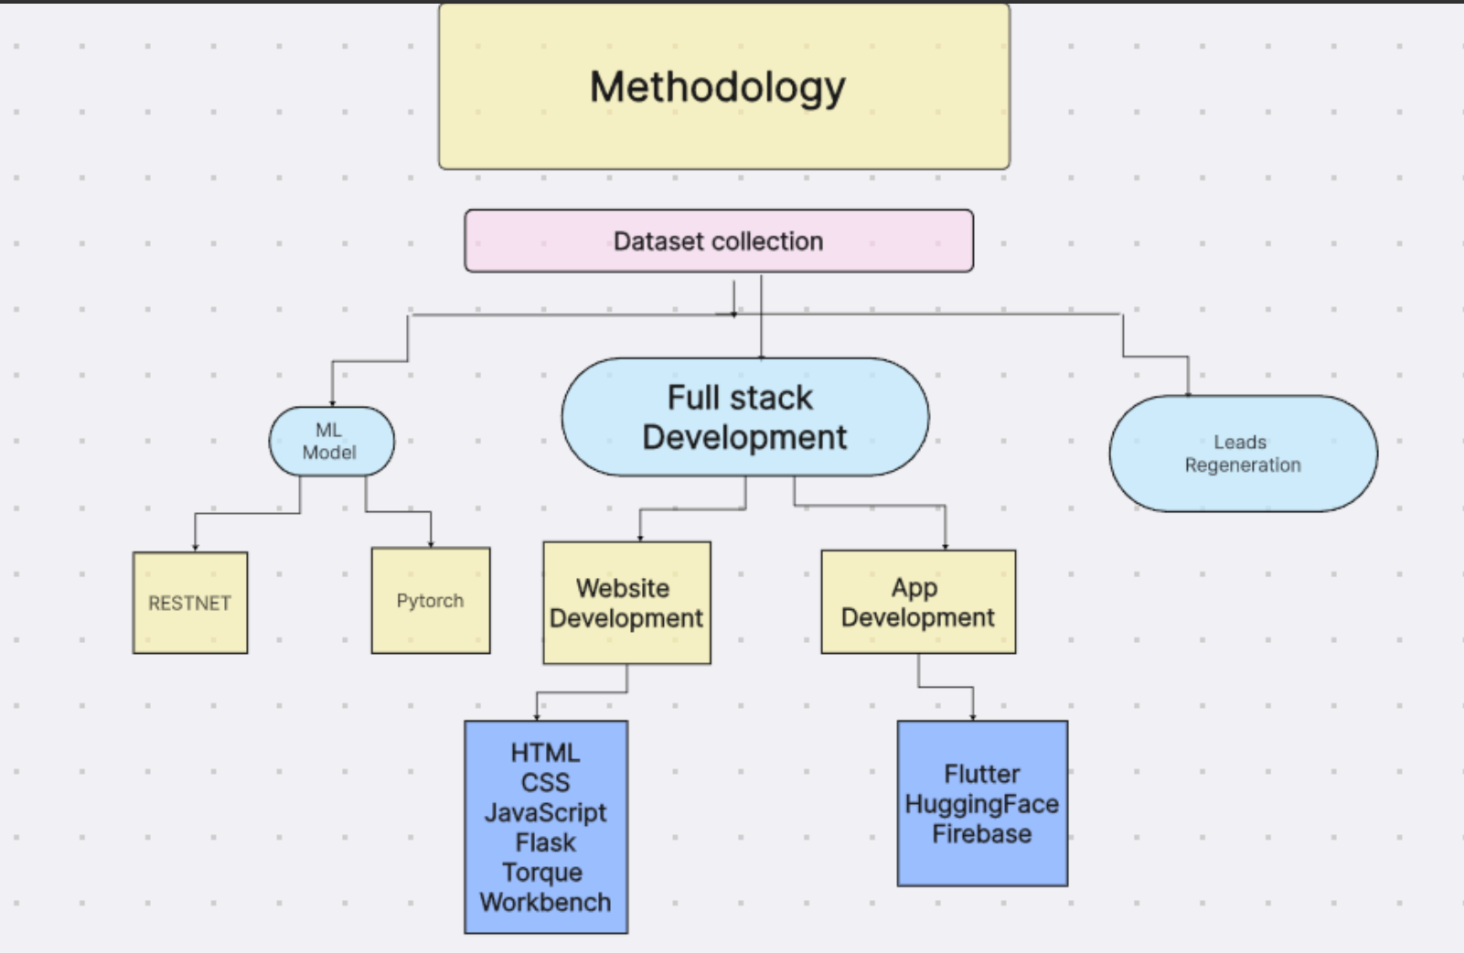
Model Architecture in detail

Slide 10
Experimentation
Mobile Application: Real-time ECG analysis using Flutter for a user-friendly app and Firebase for backend scalability.
Web-Based System: Centralized ECG processing with HTML, Flask for real-time classification, and SQL for secure data storage.
Machine Learning Model: ResNet-18 integrated in both approaches, with preprocessing and 97% classification accuracy.
Use Cases: Mobile app for remote monitoring; web system for clinical environments and batch processing.

Slide 11
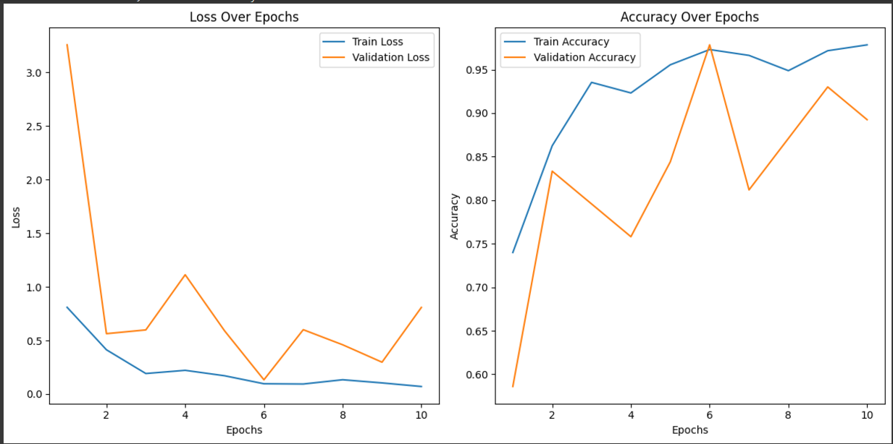
Comparison of Results with Graphical Representation

Slide 12
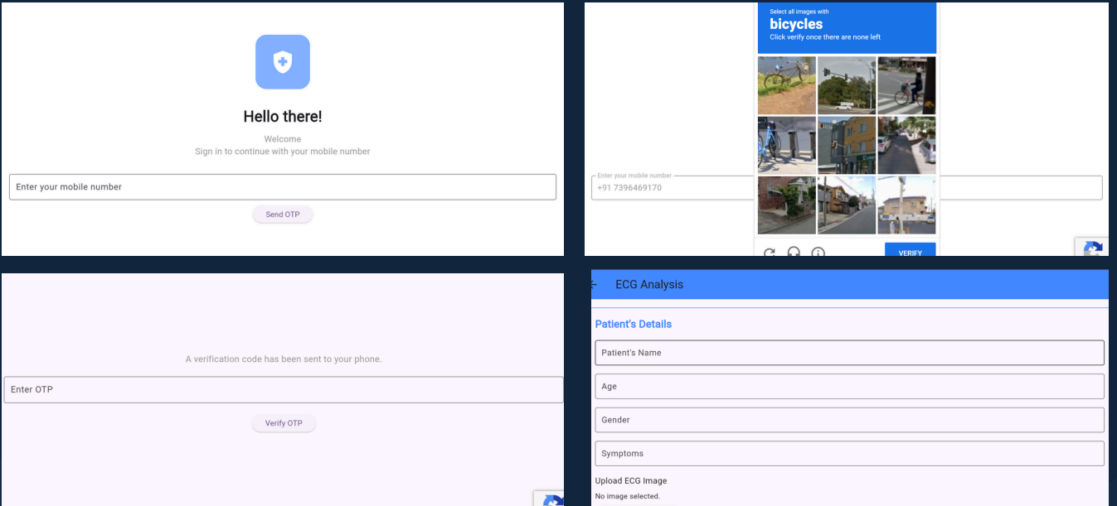
Execution

Slide 13
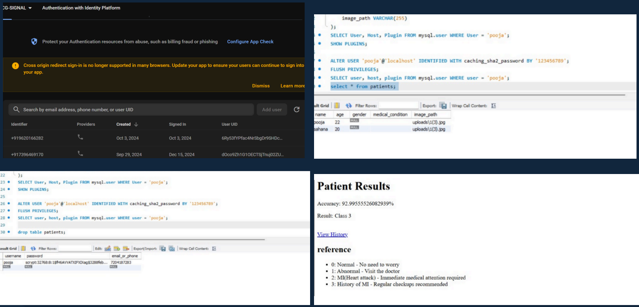
Execution

Slide 14
Publication
ECG PREDICTION AND ANALYSIS USING MACHINE LEARNING TECHNIQUES
This paper s intended to be submitted for presentation at the Live International Cardiology Conference (https://indialiveintcardiology.com/Home , organized by CDSIMER and led by Dr. Kiran, on January 25, 2025. The findings of this research aim to contribute significantly to advancements in ECG classification using state-of-the-art deep learning models, with a focus on improving diagnostic accuracy in clinical practice

Slide 15
References
[1] Poonja, Hasnain Ali, et al. "Evaluation of ECG based Recognition of Cardiac Abnormalities using Machine Learning and Deep Learning." 2021 International Conference on Robotics and Automation in Industry (ICRAI). IEEE, 2021.
[2] Amri, M. Faizal, Muhammad I. Rizqyawan, and Arjon Turnip. "ECG signal processing using offline-wavelet transform method based on ECG-IoT device." 2016 3rd international conference on information technology, computer, and electrical engineering (ICITACEE). IEEE, 2016.
[3] Guo, Jiayu, Wangze Li, and Huichun Huang. "An ECG detection device based on Convolutional Neural Network." 2023 8th International Conference on Intelligent Computing and Signal Processing (ICSP). IEEE, 2023.

